Slide 1



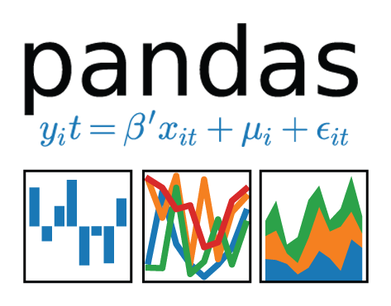

Increasing product brand's visibility using social media
Alexandre Geraldo
Austin Brantley
Franklin Gonzales
Prashanth Saseenthar
Georgia Tech Data Science and Analytics Boot Camp 2019

Slide 2
Before we start
Useful links (also available on Slack)
GitHub repository
https://github.com/ageraldo1/DataScienceProject1.git
Jupyter notebooks
https://github.com/ageraldo1/DataScienceProject1/tree/master/documents/analysis/videos
Nbviewer(online viewer)
https://nbviewer.jupyter.org/github/ageraldo1/DataScienceProject1/blob/master/documents/analysis/videos/alex/Videos%20Analysis.ipynb
API source code
YouTube
https://github.com/ageraldo1/DataScienceProject1/blob/master/src/api/youtube/generate_video_lenght_ds.py
https://github.com/ageraldo1/DataScienceProject1/blob/master/src/api/youtube/generate_video_lenght_ds.py
Sentimental Analysis
https://github.com/ageraldo1/DataScienceProject1/blob/master/src/sentimental/sentimental_analysis.py

Slide 3
Agenda
Motivation & Inspirations
Data Cleanup & Exploration
Merging, fixing datatypes, removing duplicate records
New datasets (Google YouTube API, vaderSentiment)
Data Analysis
Summary
Time Series
Trends
Views per category
Views Distribution per Category
Used Tags
Sentimental Analysis
Top 10 Creators & Categories
Videos Duration (optional)
Ratios per Categories (optional)
Correlations
Correlation between metrics
Correlation between Title Sentiment and Views
Correlation between Tags Sentiment and Views
Correlation between Total of Subscribers & Total of Uploads and Views
Making the Call
Q & A

Slide 4
Motivation & Inspirations
“If you can't explain it simply, you don't understand it well enough.”
Albert Einstein

Slide 5

Motivation & Inspirations
Social networks are one of the fastest growing industries in the world.
Social Media is crucial for Business Marketing.
Data Science & Big Data Science & Data Analytics flavors mixed in one place.
Entrepreneurial spirit.
Several paths can be explored.
Topic of easier understanding and most of the people like to talk about.

Slide 6
Why YouTube?
It has a wide reach and generates plenty of traffic.
YouTube has over 1 billion users, who spend millions of hours per day viewing videos.
YouTube is localized in over 70 countries and is available in 76 languages.
It has greater reach than cable in the US.
Pay Per (Actual) View Of Your Ad.
One of the shortest path to connect your brand to people around the world.

Slide 7

How a trending dataset can help?
Helps viewers see what's happening on YouTube and in the world.
Trending video = Video running on steroids.
Potential to connect to people on a large scale.
Views = People.
Video visualization is a trigger to connect people with product.
Keep up the momentum.

Slide 8

Limitations
Unable to identity if a person see a video more than once.
Unable to retrieve information of removed channels.
Unable to retrieve information of removed videos.

Slide 9
Data Cleanup & Exploration
“Torture the data, and it will confess to anything.”
Ronald Coase

Slide 10
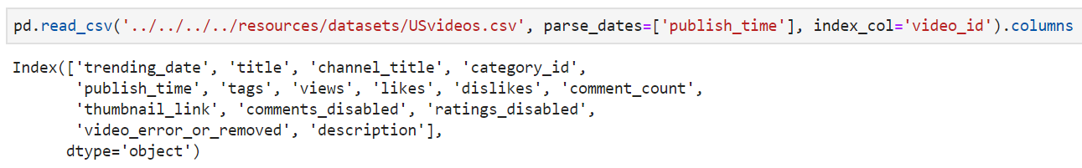
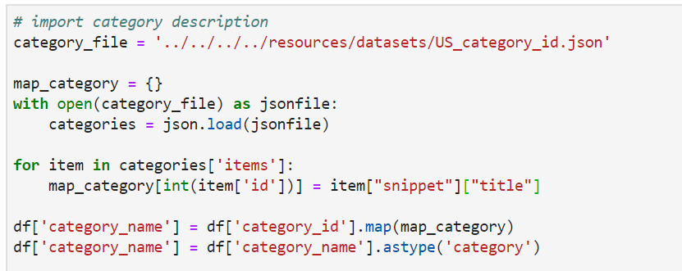
Merging, fixing datatypes, removing duplicate records.
Dataset : USvideos.csv
Description : Kaggle's dataset that contains a list of top trending videos of US.
Importing Category Description

Slide 11
Merging, fixing datatypes, removing duplicate records.
Fixing trending date attribute
Removing duplicate records
Adding new attributes

Slide 12
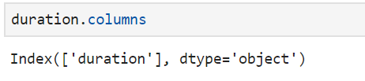
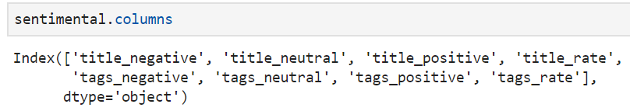
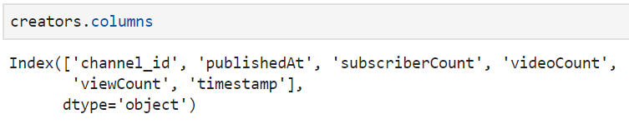
New Datasets : duration, sentimental, creators
Dataset : USvideos_duration.csv
Description : Video duration dataset created using YouTube APIs.
Source code : src/api/youtube/generate_video_lenght_ds.py
Dataset : US_sentimental.csv
Description : Sentimental analysis of videos titles and videos tags created using Vader sentimental package.
Source code : src/api/youtube/src/sentimental/sentimental_analysis.py
Dataset : USchannels.csv
Description : channel creators dataset created using YouTube APIs.
Source code : src/api/youtube/generate_video_lenght_ds.py

Slide 13
Data Analysis
“If we have data, let’s look at data. If all we have are opinions, let’s go with mine”
Jim Barksdale

Slide 14
Summary Question #1 : What valuable trends can we extract from our dataset?
Excellent amount of data.
2M of Views on Average.
Data is spread-out by 7M of Views.
Total number of views is almost 38 times higher than US population (2018).
Write down the number of max visualizations (225M). We'll be using it in the end of the presentation.
Notes:
Observation : The dataset provides a total of 6.351 videos and 2.198 channels. The timeframe of the dataset covers around eleven months (between Nov-2017 until June-2018). The dataset has the potential to connect our efforts in the marketing campaign with almost 2M people(views) on average. A standard deviation of 7M in additional with the enormous difference between the average and the median gives us the inside how spread out the dataset is. The maximum number of views also give us another inside for potential outlier(s) inside of the dataset. The total number of views is almost 38 times higher than US current population.

Slide 15
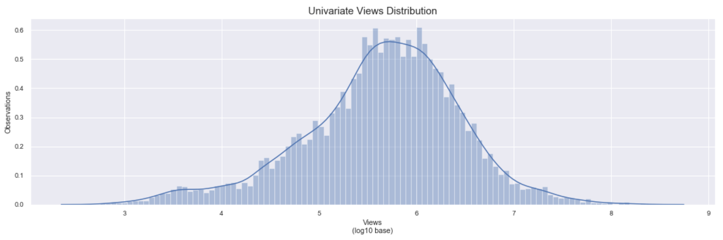
Summary Question #2 : Can we predict the potential to reach a number X of people ?
Probability distribution
Quantiles
Notes:
Observation : Comparing the probability distribution of the total number of views versus the quantiles split in a range of 10%, we can start predicting some more realistic potential numbers of people that the marketing campaign might achieve using YouTube. Something to notice is the fact the from 70% to 80%, the difference between the total of numbers of views is minimum. Another important fact is 99% of the views represents a total of 25M. Therefore, a total of 225M views is an estimate that should be considered as an outlier.

Slide 16
Time-Series
“If you can look into the seeds of time, and say which grain will grow and which will not, speak then unto me.”
William Shakespeare

Slide 17
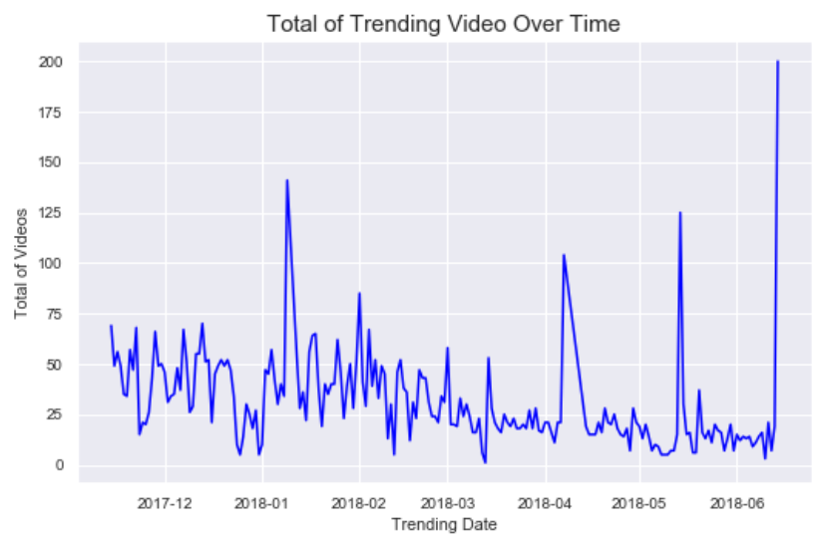
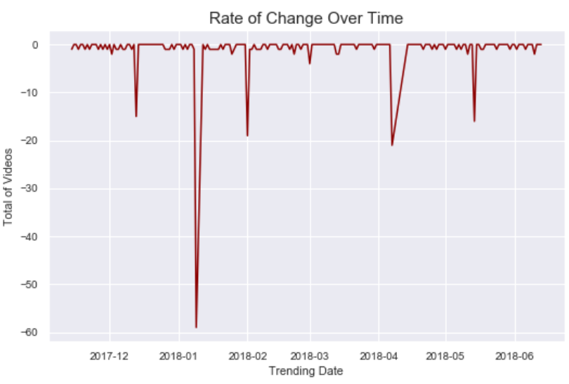
Time Series Question #3 : How trending videos activity looks live over time?
Insights for deployment campaign dates
Reveal activity behaviors
Powerful insight to drive decisions
Reveal the speed of when activity is changing.
Reveal activity behaviors.
Reveal maximum and minimum behaviors.
Notes:
Observation : Once the status of a video change from publishing to trending, it means that the potential to reach more people increase on an exponential scale. Observing this behavior can give us insights to plans for deployment dates for the marketing campaign. A higher number of trending videos, higher are the chances to reach more people. No trending videos at all mean that we need to find new ways to reach people. January, April, and May seems to be months of more activity for trending videos.

Slide 18
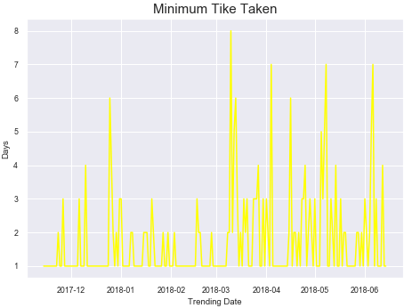
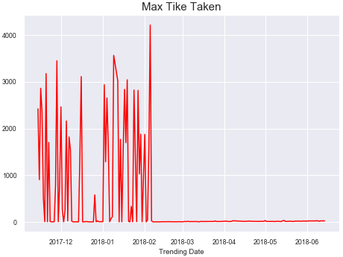
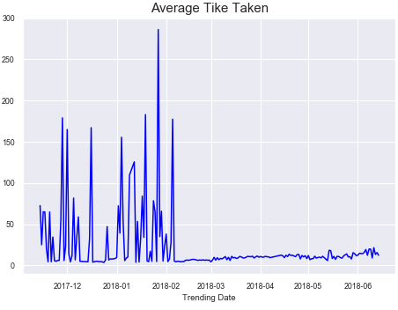
Time Series Question #4 : How long takes for a video become a trending video ?
Takes forever between December and February
The “miracle” from March through June
Christmas & End of Year side effects
Notes:
Observation : It's important also to observe the rate of change of the trending video. The activity tends to remains constant over time. The numbers of days required for a video change the status from published to trended in December through February in average is huge. There is definitely something causing this phenomenon for these months. January presents two behaviors: a higher number of trending videos and higher time taken for video status change.

Slide 19
Trends
“The problem with data is that it says a lot, but it also says nothing.”
Sendhil Mullainathan

Slide 20
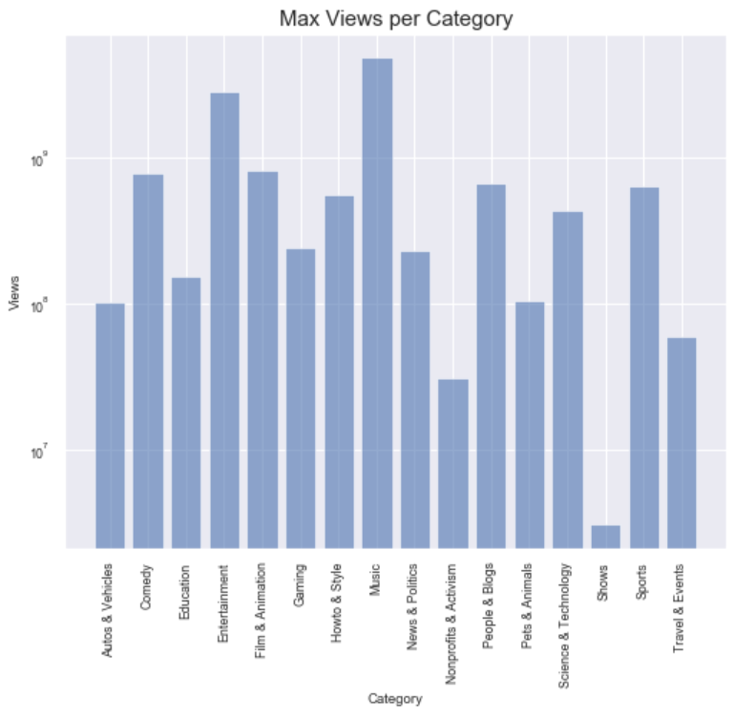
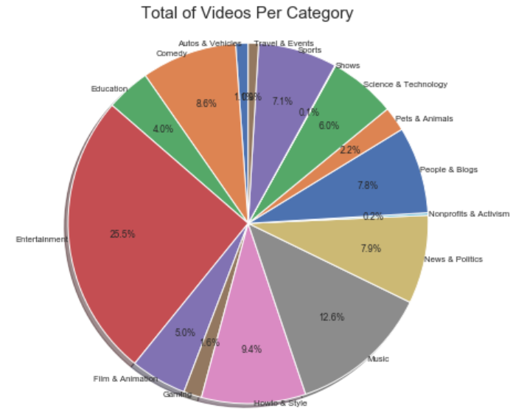
Trends Question #5 : What are the categories dominating YouTube?
Music and entertainment categories dominate the total of views.
Entertainment category dominate total of uploads.
Notes:
Observation : Music and entertainment categories dominated the total number of views but comparing these two categories with the total number of trending videos, the game change. Even though the Entertainment category has a higher number of trending videos, this fact does not help in making this category to dominate also the total of views.

Slide 21
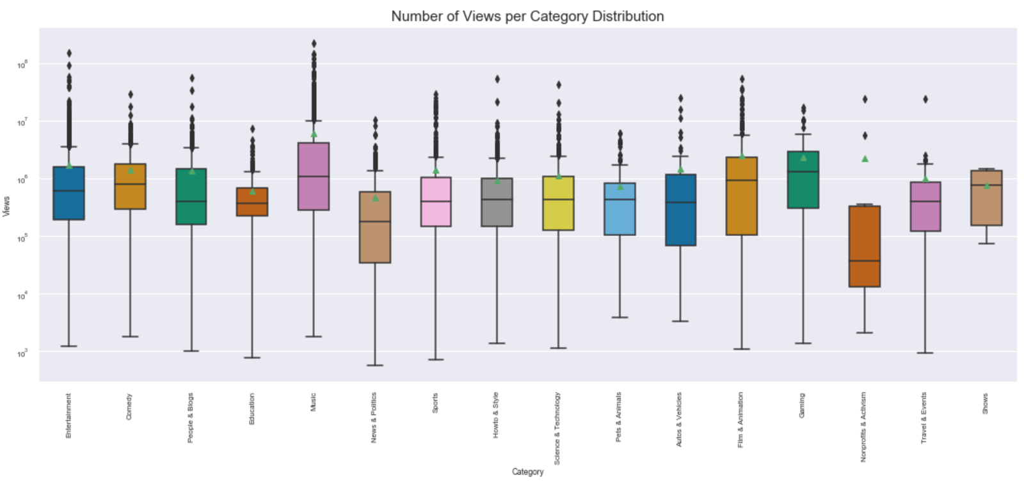
Trends Question #6 : How spread out is the data across video categories?
All categories except Show presents outliers.
Show distribution seems to be a normal distribution.
Music, Entertainment, and Film & Animations presents a considerable number of outliers.
Notes:
Observation : Analyzing the distribution for each category, we can observe that Shows presents what can be considered a normal distribution. Music and Entertainment and Film & Animations categories present a considerable number of outliers. Therefore, predicting data for these categories might be difficult due to the presence of a higher number of outliers.

Slide 22
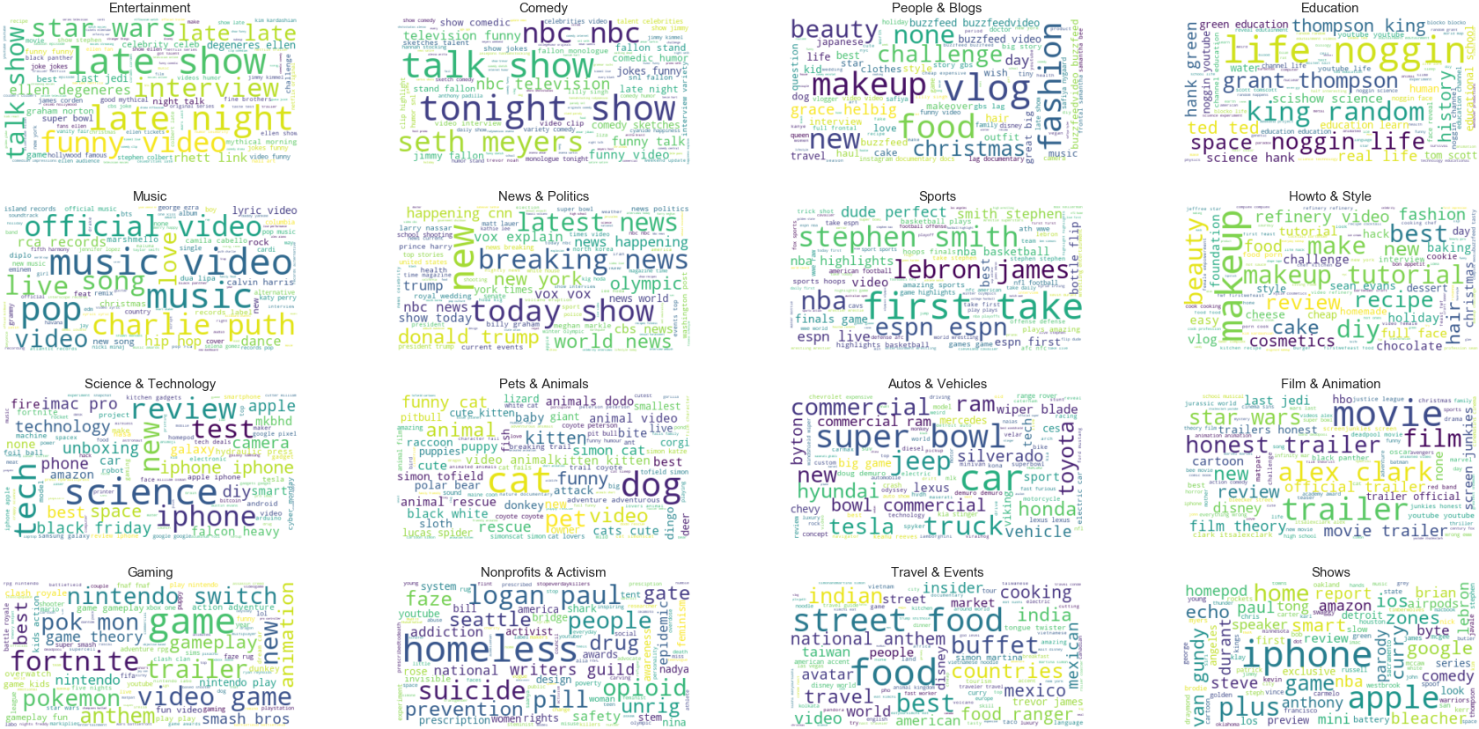
Trends Question #7 : What are the most used tags across the categories?
Discovering the word iPhone as one of the most used keywords for the Shows category still remains a secret for the group members.
Notes:
Observation : According to YouTube, tagging is one of the most important ways to rank your video in YouTube search results: Tags help users find your video when they search the site. When users type keywords related to your tags your video will appear in their search results. Therefore, knowing the most used tags per category can provide excellent insights in order to achieve a higher number of people. Some keywords across the categories were expected such as dog or cat for Pets & Animals categories or Fornite and Pokemon for Gaming categories. Discovering the keyword iPhone as one of the most used keywords for the Shows category still remains a secret for the group members.

Slide 23
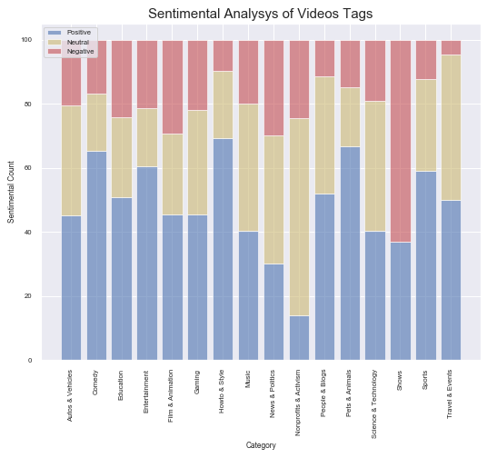
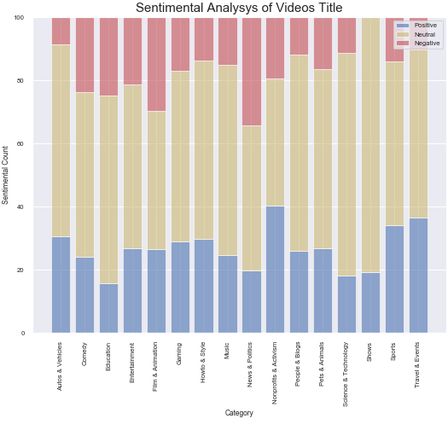
Trends Question #8 : What is the sentimental used by titles and tags across categories?
New Question :
Is there any correction between titles and tags sentiments with the number of views?
How-to & Style and Pets & Animals categories present higher positives score for tags (higher than 60%).
Nonprofits & Activism category presents the higher positive score but this score is below 50%.
Notes:
Observation : Examining the sentimental used by videos titles and tags per category can provide us directions regarding how to make to a selected product association with a specific channel or category. How-to & Style and Pets & Animals categories present higher positives score for tags (higher than 60%). In another hand, Nonprofits & Activism category presents the higher positive score but this score is below 50%. This initial analysis brings the following question: Is there any correction between titles and tags sentiments with the number of views?

Slide 24
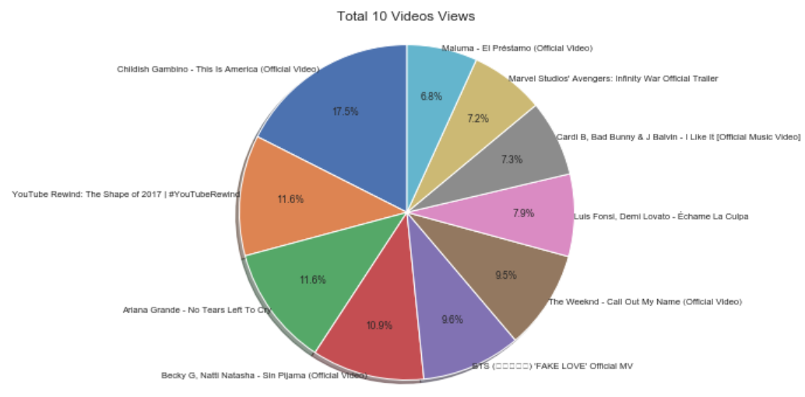
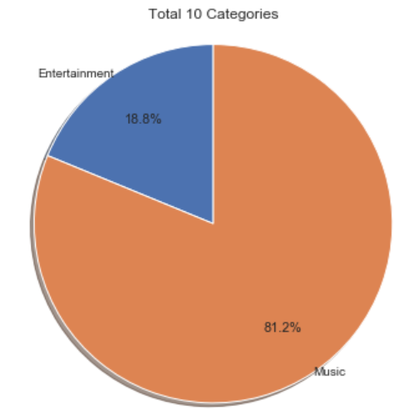
Trends Question #9 : Who are the Top 10 creators and what are the Top 10 categories ?
YouTube is a territory dominated by Music & Entertainment.
It's clear also to see that they tend to watch the same video several times. Retaining people attention is difficult and knowing where to explore this kind of behavior can potentially lead to success.
Notes:
Observation : YouTube is a territory dominated by Music & Entertainment. Any kind of association with these categories has the potential to bring an enormous number of views. As we can see, people tend to love to use YouTube to watch Music and Entertainment videos. It's clear also to see that they tend to watch the same video several times. Retaining people attention is difficult and knowing where to explore this kind of behavior can potentially lead to success.

Slide 25
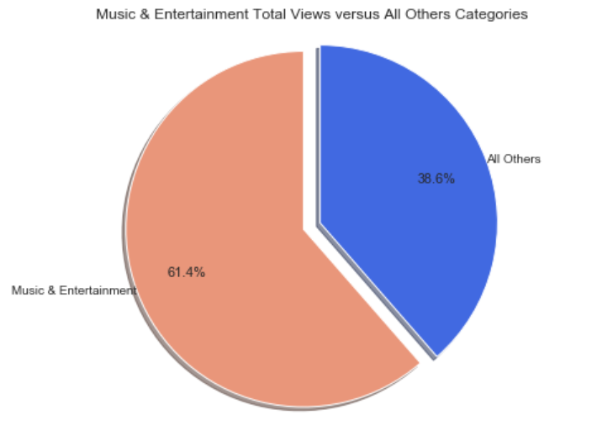
Trends Question #10 : How powerful are Music & Entertainment combined ?
See for yourself…

Slide 26
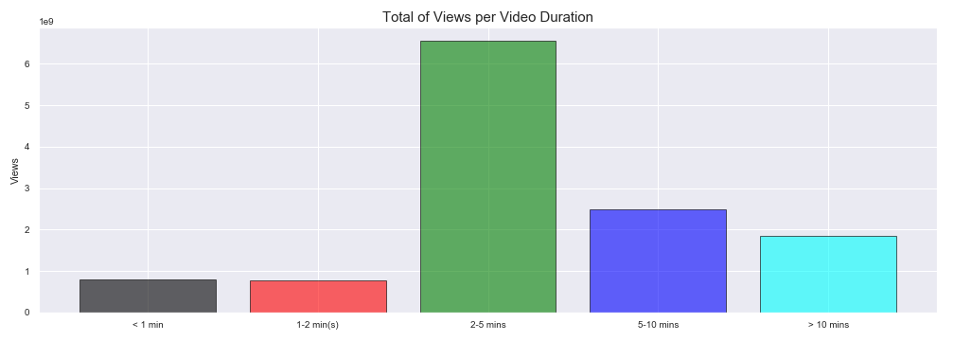
Trends Question #11 : How long should be the video duration ? (optional)
Notes:
Observation: As we can see, the video duration falls into a range duration of 2-5 minutes. Knowing how long should YouTube videos be is crucial for marketing campaign and producer efforts. Shorter videos demonstrated to be the key to success. Keep people attention for more than 5 minutes is a challenging task. Any decision in terms of video duration must take into consideration shorted videos rather than longer ones.

Slide 27
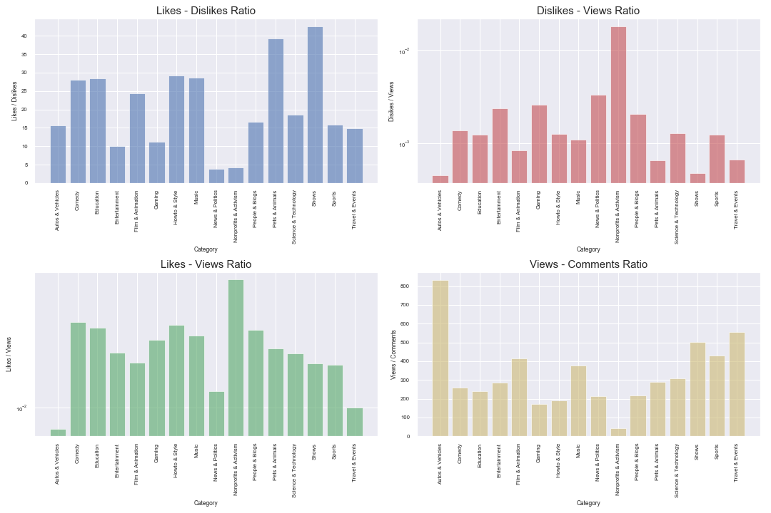
Trends Question #12 : What are the ratios across different categories? (optional)
Notes:
Observation: The ratio between Likes and Dislikes presents the expected results. Pets & Animals and Shows categories present the higher ratios scores. News & Politics and Nonprofits & Blogs categories present the lowest ratios scores. Another interesting ratio result can be observed in between Views and Comments. Autos & Vehicles, Travel & Events, and Shows categories presents higher ratio scores. Nonprofits & Activism and News & Politics present the lowest ratios score. Higher Likes and Dislikes ratios can be used to measure people satisfaction. More Likes can bring more Views. Higher Views and Comments ratios can be used to explore more direct communication with your audiences. Hearing your audiences opinion is crucial for the business.

Slide 28
Correlations
“One of the first things taught in introductory statistics textbooks is that correlation is not causation. It is also one of the first things forgotten.”
Thomas Sowell

Slide 29
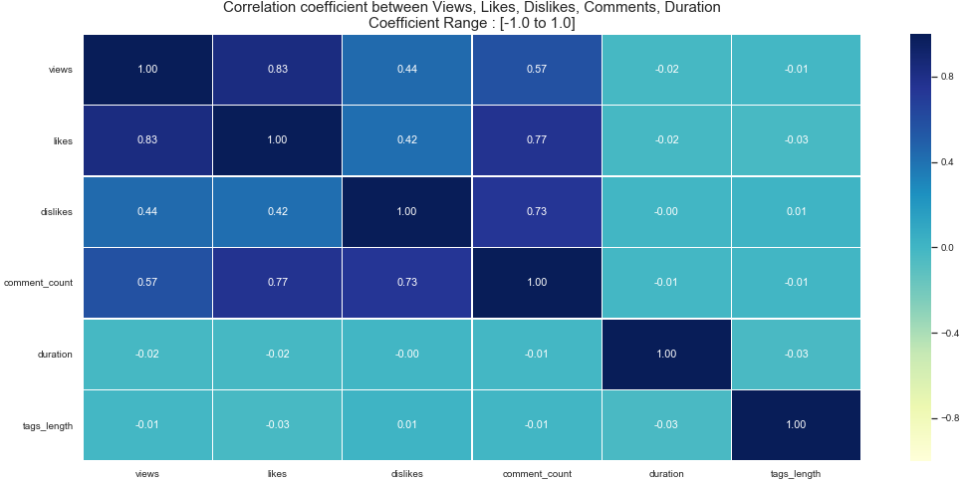
Correlations Question #13 : Is there any correlation between views, likes, dislikes, comments, duration, or tags ?
Stronger correlations :
Views and Likes
Likes and comments
Dislikes and comments
Weaker correlations :
Video duration
Tags
Notes:
Observation: Views and Likes presents are a strong correlation which was expected. Not surprisingly the correlation between views and comments is not so strong due to the fact that not the majority of the viewers make comments of a video. Another not so strong correlation is between Views and Dislikes which tells us that might have more factors involved that make a person dislike a video. The biggest surprise in this correlation analysis is the weaker correction between Views and Video Duration. The result was unexpected by all members of the group. All additional studies that were performed by the group indicated us a strong correlation between Views and Video duration but this hypothesis proved to be wrong at least for trending videos.

Slide 30
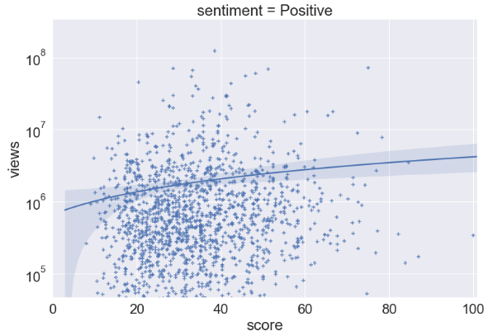
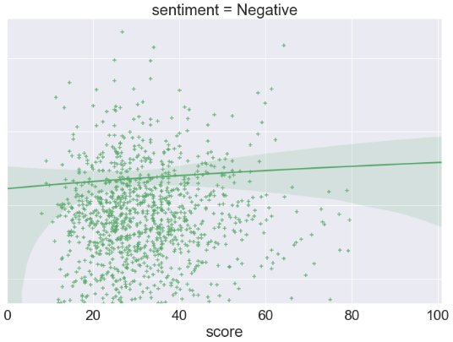
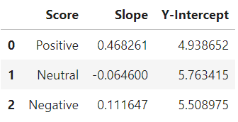
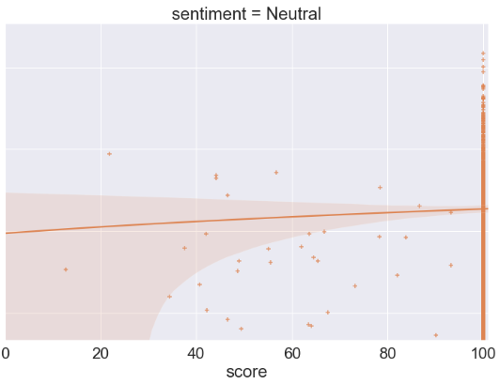
Correlations Question #14 : Is there any correlation between Title Sentiment and Views ?
Hard to tell if there is any correlation
A positive correlation can be observed when the title sentiment is positive.
A positive correlation can be observed when the title sentiment is negative.
Notes:
Observation: Needs more analysis

Slide 31
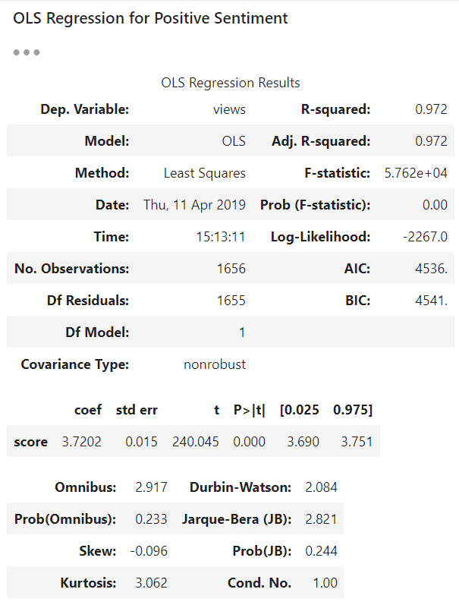
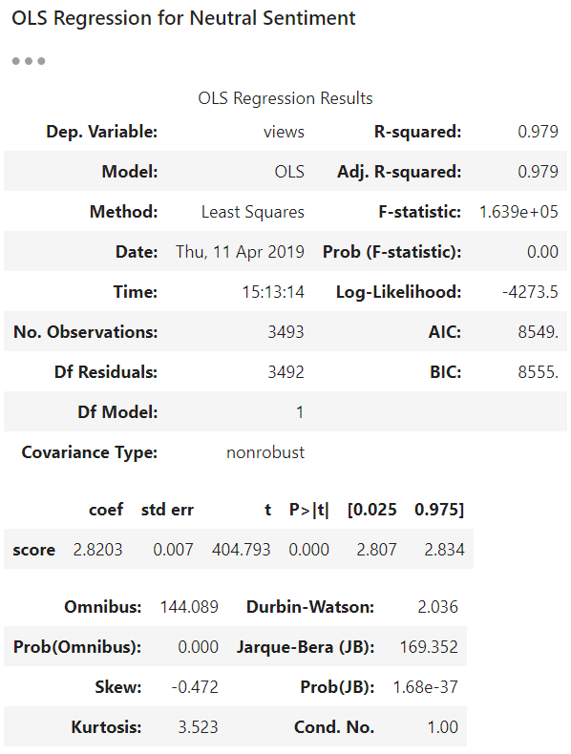
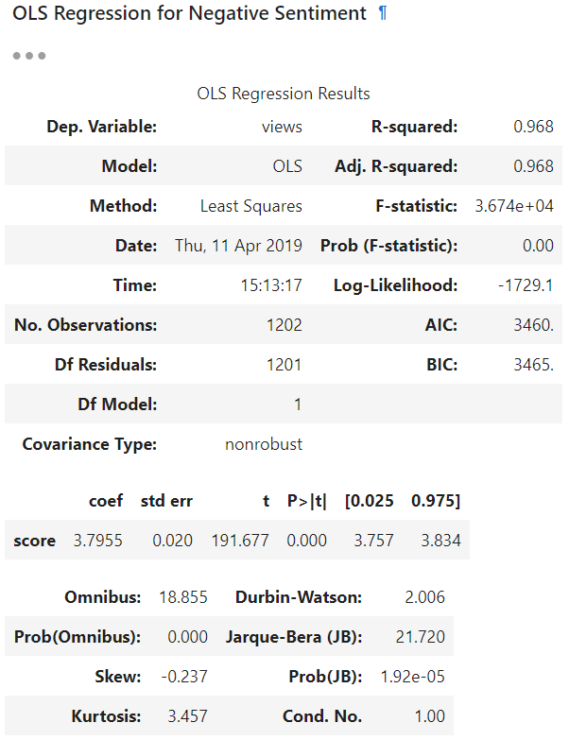
Correlations Question #14 : Is there any correlation between Title Sentiment and Views ?
What does OLS Regression test tell us?
R-squared score > 0.9
P-value score < 0.001
Notes:
Observation: As we can see, the title sentiment has a strong correlation. As the positive or negative score increases, the number of views also increase. R-squared score presents a result of 0.97 indicating a strong relationship between the two variables. Another really good indicator is the p-value score which is below 0.001. It means that the results were highly significant. Or, in other words, they're very unlikely to have occurred by chance alone

Slide 32
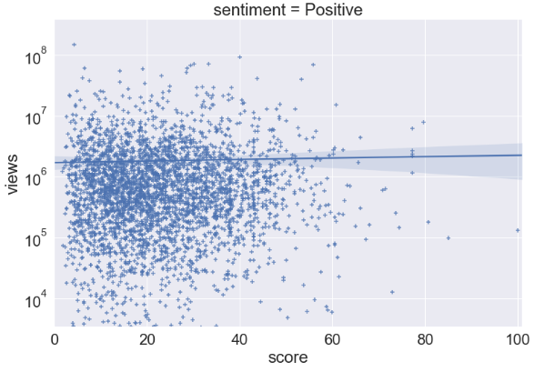
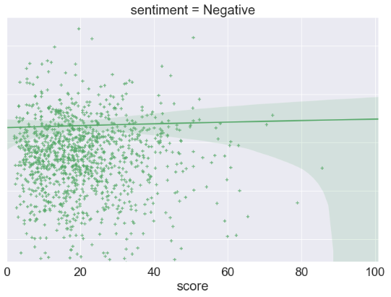
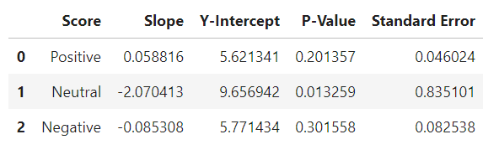
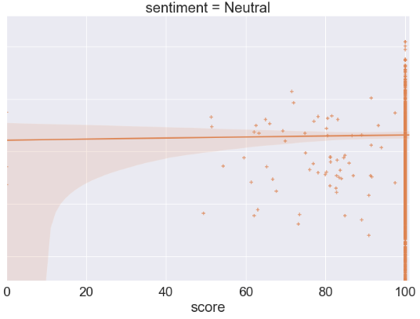
Correlations Question #15 : How about correlation between Tags Sentiment and Views ?
Not satisfactory results.
Hypothesis rejected.
Notes:
Observation: The correlation between tags sentiment and views presented not satisfactorily results. A higher score for p-values and standard errors can be examined for this analysis. The hypothesis-test of the existence of a correlation between the sentiment of the tags and the number of views was rejected.

Slide 33
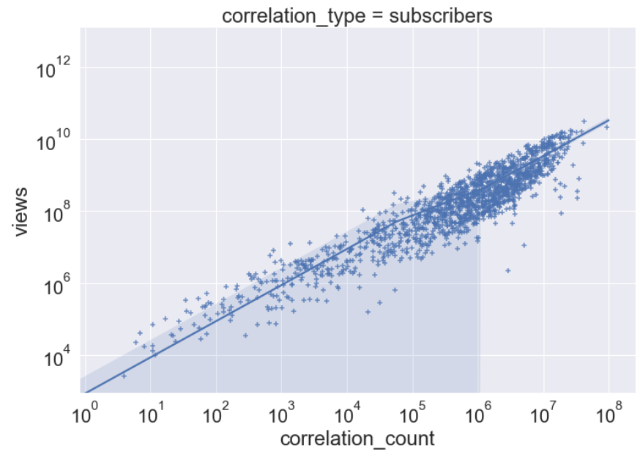
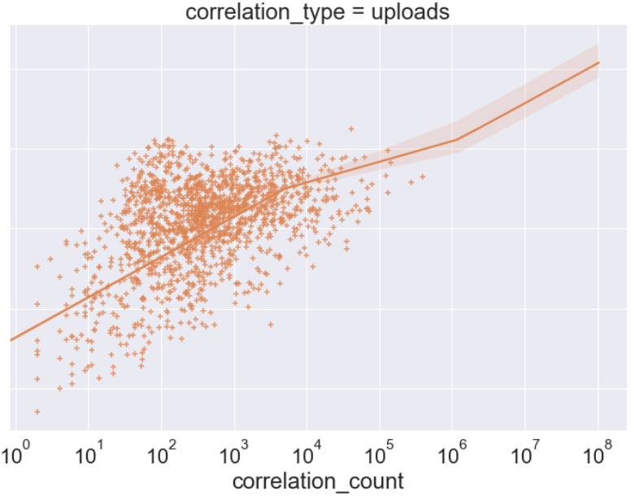
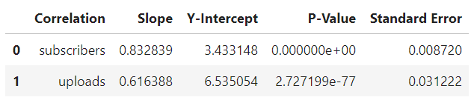
Correlations Question #16 : Is there any correlation between Subscribers, Uploads, and Views?
Expected results.
Notes:
Observation: As expected, the correlation between subscribers and views is strong. The same behavior can be examined for the correlation between uploads and views. R-squared score presents a result of 0.98 indicating a strong relationship between the two variables. Another really good indicator is the p-value score which is below 0.001. Therefore, the number of subscriber of a channel and the total of uploads has a direct relationship with the number of views. As one variable increase, the other also increases.

Slide 34
Making the call
“The hardest choices require the strongest wills.”
Thanos
Avengers: Infinity War

Slide 35
Making the call
YouTube definitely can provide the means to conquer our main goal which is by increasing a product brand's visibility. Using the YouTube platform we may gain the potential to reach 518 thousands of people on average. In order to maximize the potential, we propose the following deployment plan:
Product’s brand identity
Channel boost
Register a channel on YouTube and choose a channel name that correlates the name with the product brand.
Create videos no longer than 5 min to explain everything related to the product and the target public. Adjust storyboarding over time.
Choose the right tags for your videos based on the product's category. YouTube search algorithm relies on heavily in keywords for the video search.
Choose carefully the words for the video titles. There is a strong correlation between title sentiment and number of visualizations.
Publish videos between March and June. The average time for a video be marked and trend takes on average 20 days.
Invest in YouTube Video Advertising Campaign. Using popular channels such as Music and Entertainment has the potential to produce good results on ROI scores.
Boosting your channel you also boots your brand identity and customer.
Use the same formula for other social platforms such as Facebook, Twitter, etc. All these platforms are somehow connected.
As the number of subscribers and uploads increase over time, there is a strong correlation showing that the number of views will also increase.

Slide 36
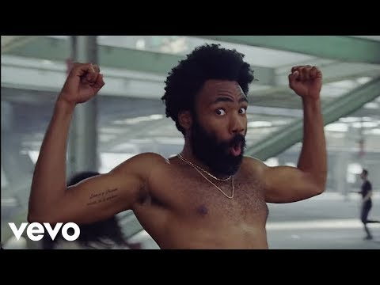
Q & A
Before we open the Q & A session, let’s review the outlier of the year for YouTube trending dataset:
Childish Gambino
This Is America (Official Video)
Did you have any doubt that the Music category will be the outlier of the year?

Slide 37
Q & A
Thank you all for your attention!

